Slide 1

Coping in Content Moderation: Emotion Regulation, Mental Health, and Burnout in Commercial Content Moderators
Casey J. Hopper (He/Him)
Department of Psychology, Thompson Rivers University
PSYCH 4990: Honours
Dr. Catherine Ortner and Hayleigh Armstrong

Slide 2
Land Acknowledgment
I humbly acknowledge that this presentation is taking place on the traditional lands of the Tk’emlúps te Secwépemc within the Secépemc’ulucw, the traditional and unceded territory of the Secwépemc peoples. I also acknowledge that I am uninvited visitor on these lands and I am grateful to live, learn, work, and love here.

Slide 3

Content Moderators
Content moderators remove explicit content from online platforms (Roberts, 2016)
Mental health and well-being may be adversely affected (Wohn, 2019)
Notes:
As our world continues to become more technologically advanced, keeping social media platforms safe is becoming increasingly important. Therefore, moderators of these platforms serve a vital role in protecting users.
Content moderators are digital gatekeepers that remove illegal or disturbing content from online platforms (Roberts, 2016).
Importantly, content moderators must view explicit content that may be violent, pornographic or discriminatory in nature (Roberts, 2016). In addition to this, viewing of this explicit content is very repetitive in nature (Steiger et al., 2021).
Given the repeated and explicit nature of the content these individuals view, their wellness and mental health may be adversely impacted (Wohn, 2019).
However, there is a lack of empirical research on how content moderators’ mental health is impacted
Nor has research investigated how content moderators may regulate their emotions in order to cope with the negative content they view.

Slide 4
Content Moderators: The risks of their work
Reported exposure to both primary and secondary/vicarious trauma (Wohn, 2019).
May develop symptomology PTSD (Posttraumatic Stress Disorder) (Feinstein et al., 2014; Pierce & Lilly, 2012).
Detrimental effects of exposure on secondary trauma for employees in similar occupations (Burns et al., 2008).
Notes:
Only recently has content moderation been widely discussed in an academic setting.
Secondary trauma is likely to occur when a content moderator is exposed to content in which an individual is traumatized themselves and in turn the moderator is exposed to the traumatic content indirectly (Wohn, 2019).
Vicarious trauma is when individuals view traumatic content and change their view of themselves and others due to watching others go through a traumatic event
Although there is a lack of scientific research investigating this issue, studies on similar highly stressful occupations have suggested that being indirectly exposed to traumatic content may have detrimental consequences for mental health. For example, many journalists exposed to graphic user-generated content and 911 telecommunicators reported experiencing symptomology similar to that expressed in people with posttraumatic stress disorder (PTSD) (Feinstein et al., 2014; Pierce & Lilly, 2012).
Also, investigators on police teams investigating Internet Child Exploitation (ICE) are exposed to extremely explicit content involving young children and may experience the effects of secondary trauma
ICE team members reported large amounts of burnout symptoms (Burns et al., 2008).
Overall, the effects of secondary trauma likely influence content moderators, given the repetition and explicit content they view. It is important to understand how content moderators respond to frequent emotionally evocative events. However, to date, there is no published research investigating emotion regulation in commercial content moderators.

Slide 5
Emotion Regulation
Attempting to alter how an individual experiences or expresses emotions, and the type of emotion they experience (Gross, 2015)
Effective regulation is critical for our mental health (Beck, Rush, Shaw, & Emery, 1979; Troy et al. 2010)
Notes:
Emotion Regulation
Emotion regulation involves attempting to alter how an individual may experience or express emotions, and the type of emotion they experience (Gross, 2015).
This process may be conscious or unconscious and may alter the negative affect a person may experience (Gross. 2002; Troy et al. 2010).
Interestingly, effective regulation of emotions is critical for our mental health and protects us against depressive symptoms and psychopathology more broadly (Beck, Rush, Shaw, & Emery, 1979; Troy et al. 2010). In addition to this, disorders such as depression and anxiety are viewed as difficulties in emotion regulation (Aldao & Nolen-Hoeksema, 2010).

Slide 6
Emotion Regulation: Cognition-focused Strategies
Cognitive Reappraisal
Adaptive strategy
Rumination
Maladaptive strategy
Notes:
Reappraisal involves altering an interpretation of an emotional event to reduce distress outcomes (Aldao et, 2010; Gross, 2001; Troy, Wilhelm, Shallcross & Mauss, 2010).
This strategy predicts reduced negative emotion, increased positive emotion, and positive health outcomes (Aldao et, 2010; Gross, 2001; Troy et al. 2010).
. Reappraisal could be if the CM thinks to themselves (“this situation could be a lot worse),
Given that content moderators are repeatedly exposed to explicit content over which they have no control, reappraisal is likely an effective strategy for them to use to decrease depressive symptoms in times of highly stressful events.
Overall, because of the positive outcomes associated with reappraisal, it is often considered an adaptive emotion regulation strategy. Meaning, it is associated with positive mental health outcomes.
Rumination:
A common maladaptive emotion regulation strategy is rumination.
This cognitive process involves focusing intensely on negative aspects of an emotional experience in a way which does not activate problem solving in an individual
Unsuccessful emotion regulation or persistent use of maladaptive strategies is related to developing symptoms of mental disorders

Slide 7



Burnout and Emotion Regulation
Cognitive Reappraisal
Rumination
Burnout:
Notes:
-I have chosen to look at burnout because this is one aspect of mental health that similarly highly stressful occupations have investigated alongside ER.
-Burnout consists of: emotional exhaustion, depersonalization and lack of personal accomplishment (Schaufeli & Greenglass, 2001).
-Use of cognitive reappraisal is associated with reduced burnout
-Use of rumination is associated with higher burnout rates

Slide 8
Predictions
Reappraisal = negatively associated with burnout and psychopathology symptoms
Rumination = positively associated with burnout and psychopathology symptoms
Notes:
In the current study, we shall be investigating how content moderators regulate their emotions in response to repeatedly viewing explicit content.
Specifically, the proposed correlational study will investigate how emotion regulation strategies (cognitive reappraisal and rumination) predict mental health outcomes in content moderators.
I predict that the use of reappraisal will be negatively associated with burnout and psychopathology symptoms. Also, use of rumination will be associated with higher levels of burnout and psychopathology symptoms.

Slide 9
The Proposed Study: Participants
N = 200
Recruitment method
  Rebuilding Thoughts
  Email
Inclusion criteria:
    18-55 years old, US or Canada
    English fluency
    3 months as content moderator
Compensation
  $10 USD
Notes:
the current study:
Participants (approximately N = 200) will be recruited from Rebuilding Thoughts, an emotional wellness service offering Content moderator employees one-to-one and group therapy/ coaching.
Participants will be invited to complete the same measures a second time after 6 months.
Participants will complete online measures of emotion regulation, mental health, and well-being via the Gorilla platform.
To be eligible for this two-part study, participants must reside in Canada or the United States, and have been employed as a content moderator for a minimum of three months.
Participants who complete all parts of the study will receive compensation for their. Compensation for part one will be $8 and compensation for part two will be $12.

Slide 10

The Pilot Study
N = 30
Recruitment method
Prolific
General population (not content moderators)

Slide 11
Self-Report Measures
PTSD
Posttraumatic Stress Disorder Checklist for DSM-5 (PCL-5; Blevins et al., 2015)
Anxiety, stress & depression
Depression Anxiety and Stress Scale-21 (DASS-21; Lovibond & Lovibond, 1995)
Burnout
The Oldenburg Burnout Inventory (OLBI) (Demerouti et al., 2010)
Emotion Regulation
Cognitive Emotion Regulation Questionnaire (Garnefski, Kraaij & Spinhoven 2001)
Notes:
The Depression Anxiety Stress Scale (DASS).
The DASS consists of 21 items assessing three categories of negative emotional states: depression, anxiety, and stress
Well-being. Participants will complete a battery of measures assessing hedonic and eudaimonic well-being (including the Satisfaction with Life Scale, Experience of Meaning, and measures of
The Oldenburg Burnout Inventory: Consists of 16 items
Assesses two core dimensions of burnout: exhaustion and disengagement

Slide 12
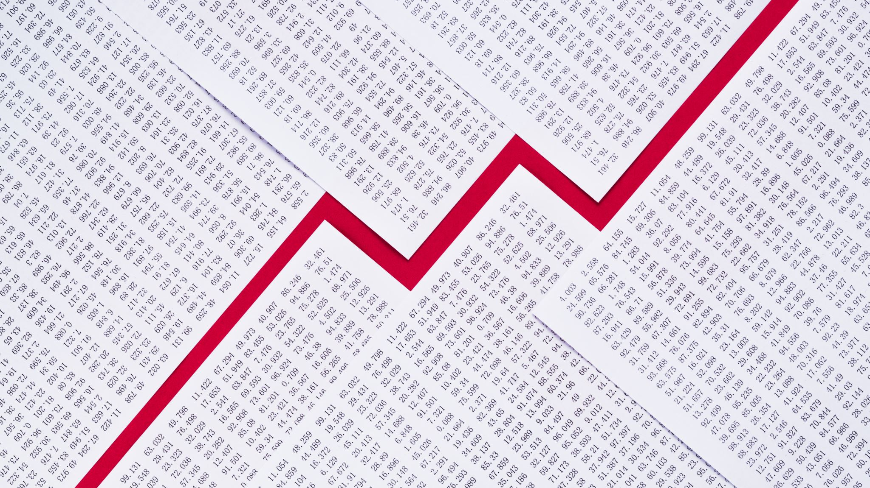
Pilot Study Results
Notes:
-I ran three multiple regression were analyses to assess reappraisal and rumination as predictors of PTSD (as captured by PCL-5 scores), mental health (depression, anxiety and stress as captured by the DASS), and burnout (as captured by OLBI scores), in content moderators.
-A multiple regression test revealed that both reappraisal and rumination were not significant predictors of PTSD (PCL-5). And while controlling for reappraisal rumination was not a sign. Predictor of PTSD and vise vera.
-A multiple regression test revealed that both reappraisal and rumination were not significant predictors of MENTAL HEALTH (DASS). And while controlling for reappraisal rumination was not a sign. Predictor of PTSD and vise vera.
-A multiple regression test revealed that both reappraisal and rumination were not significant predictors of BURNOUT (OLBI). And while controlling for reappraisal rumination was not a sign. Predictor of PTSD and vise vera.
-
-

Slide 13
Demographic Results
N = 30
Female n = 12, male n = 18
White 56.7% , Asian 20%, Black 13.3%, Mixed 6.7%, Other 3.3%

Slide 14
Predictor Variables
Reappraisal
Rumination
Notes:
-I ran three multiple regression analyses to assess reappraisal and rumination as predictors of PTSD (as captured by PCL-5 scores), mental health (depression, anxiety and stress as captured by the DASS), and burnout (as captured by OLBI scores), in content moderators.

Slide 15
Outcome Variables
PTSD = PCL-5
Mental health = DASS
Burnout = OLBI
Predictor Variables
Notes:
-I ran three multiple regression analyses to assess reappraisal and rumination as predictors of PTSD (as captured by PCL-5 scores), mental health (depression, anxiety and stress as captured by the DASS), and burnout (as captured by OLBI scores), in content moderators.

Slide 16
Results: Emotion Regulation and PTSD
Overall model: F(2, 27) = 2.54, p = .098, adjusted R² = .096.
Notes:
-A multiple regression test revealed that both reappraisal and rumination were not significant predictors of PTSD (PCL-5). And while controlling for reappraisal rumination was not a sign. Predictor of PTSD and vise vera.

Slide 17
Results: Emotion Regulation and Mental Health
Overall model: F(2, 27) = 1.54, p = .232, adjusted R² = .036.
Notes:
-As captured by the DASS
-A multiple regression test revealed that both reappraisal and rumination were not significant predictors of MENTAL HEALTH (DASS). And while controlling for reappraisal rumination was not a sign. Predictor of PTSD and vise vera.

Slide 18
Results: Emotion Regulation and Burnout
Overall model: F(2, 27) = 1.67, p = .207, adjusted R² = .044
Notes:
-As captured by the OLBI
-A multiple regression test revealed that both reappraisal and rumination were not significant predictors of BURNOUT (OLBI). And while controlling for reappraisal rumination was not a sign. Predictor of PTSD and vise vera.
-

Slide 19
Discussion
Both Reappraisal and Rumination = Not significant predictors of PTSD, mental health or burnout
Reappraisal and rumination = 9.58% of variance in PTSD scores
Notes:
-although rumination and reappraisal were not significant predictors of mental health scores, this regression revealed that 9.58% of the variance in PTSD scores were accounted for by reappraisal and rumination.
-This finding is congruent with past research on emotion regulation and PTSD. For example, research suggests there is a significant relationship between PTSD and persistent use of maladaptive strategies (i.e., rumination) (Seligowski et al., 2015). Interestingly, findings are mixed when it comes to the negative association between reappraisal and PTSD (Boden et al., 2012; Antonia et al., 2015).
Overall, although research support is mixed, research suggests that PTSD is associated with poor emotion regulation (Bonn-Miller et al., 2011).
-In addition, the relationship between emotion regulation and PTSD is strong (Bonn-Miller et al., 2011), and may explain why our reappraisal and rumination regression revealed a large amount of the variance in PTSD, although this was not significant.

Slide 20
Limitations and Future Research
Small sample size
Assessed mental health and burnout at only one time period
Assess Emotion Regulation Flexibility
Notes:
-two specific emotion regulation strategies looked at
-emotion regulation flexibility is a better predictor of mental health when compared to looking a two specific strategies
-Rather, flexibly using various repertoires in emotion regulation is more predictive of psychopathology symptoms (Aldao & Nolen-Hoeksema, 2012).
-Thus, the use of adaptive strategies prevents the development of psychopathology symptoms only when the person uses maladaptive strategies often (Aldao & Nolen-Hoeksema, 2012). Other researchers have further emphasized the role of flexibility in emotion regulation for adaptive outcomes (Aldao et al., 2015). Therefore, future studies investigating emotion regulation in content moderators should look at emotion regulation flexibility and how this may predict mental health outcomes.

Slide 21
Conclusions
Understand how moderators regulate their emotions
Design effective treatment methods
Understand the presence of psychopathology symptoms in content moderators
Notes:
-Despite these limitations, this study contributes to the limited but growing literature that investigates the importance of emotion regulation in the content moderator population.
In conclusion, the results of the present study were not entirely consistent with past research investigating the association between emotion regulation and mental health. Contrary to past findings, there was rumination nor reappraisal was predictive of mental health and burnout. Future research would allow for further insight into the nature of this relationship to enhance our emotion regulation and mental health in the unique population of content moderators.
Future research on CM’s would:
Understand how moderators regulate their emotions.
Design effective treatment methods.
Understand the presence of psychopathology symptoms in content moderators.

Slide 22
Acknowledgments
Supervisor: Dr. Catherine Ortner
Nadia Brown, Managing Partner, Rebuilding Thoughts
Collaborator Hayleigh Armstrong

Slide 23
References
Aldao, A., Nolen-Hoeksema, S., & Schweizer, S. (2010). Emotion-regulation strategies across psychopathology: A meta-analytic review. Clinical Psychology Review, 30(2), 217–237. https://doi.org/10.1016/j.cpr.2009.11.004
Beck, A. T., Rush, A. J., Shaw, B. F., & Emery, G. (1979). Cognitive therapy of depression. New York: Guilford Press.
Blevins, C.A., Weathers, F.W., Davis, M.T., Witte, T.K. & Domino, J.L. (2015). The posttraumatic stress disorder checklist for DSM-5 (PCL-5): Development and initial psychometric evaluation. Journal of Traumatic Stress, 28, 489–498.
Dörfel, D., Scheffel, C., Schweikert, T. & Gärtner, A. (in preparation). A new self-report instrument for measuring emotion regulation flexibility.
Donahue, E. G., Forest, J., Vallerand, R. J., Lemyre, P. N., Crevier-Braud, L., & Bergeron, E. (2012). Passion for work and emotional exhaustion: The mediating role of rumination and recovery. Applied Psychology. Health and Well-Being, 4(3), 341–368. https://doi.org/10.1111/j.1758-0854.2012.01078.x
Demerouti, E., Mostert, K., & Bakker, A. B. (2010). Burnout and work engagement: A thorough investigation of the independency of both constructs. Journal of Occupational Health Psychology, 15(3), 209–222. https://doi.org/10.1037/a0019408
Feinstein, A., Audet, B., & Waknine, E. (2014). Witnessing images of extreme violence: A psychological study of journalists in the newsroom. JRSM Open, 5(8),1-7. https://doi.org/10.1177/2054270414533323
Garnefski, N., Kraaij, V., & Spinhoven, P. (2001). Cognitive Emotion Regulation Questionnaire (CERQ) [Database record]. APA PsycTests. https://doi.org/10.1037/t03801-000
Gross, J. J. (2002). Emotion regulation: Affective, cognitive, and social consequences. Psychophysiology, 39, 281-291. DOI: 10.1017.S0048577201393198
Gross, J. J. (2015). Emotion regulation: Current status and future prospects. Psychological Inquiry, 26(1), 1–26. https://doi.org/10.1080/1047840X.2014.940781
Ijaz, T. & Khalid, A. (2020). Perfectionism and academic burnout: The mediating role of worry and depressive rumination in university students. Pakistan Journal of Psychological Research, 473-492.
Lovibond, S.H. & Lovibond, P.F. (1995). Manual for the Depression Anxiety Stress Scales. (2nd. Ed.) Sydney: Psychology Foundation.
Nolen-Hoeksema, S. (2000). The role of rumination in depressive disorders and mixed anxiety/depressive symptoms. Journal of Abnormal Psychology, 109(3), 504–511. https://doi.org/10.1037/0021-843X.109.3.504
Pierce, H., & Lilly M. M. (2012). Duty-related trauma exposure in 911 telecommunicators: Considering the risk for posttraumatic stress. Journal of Traumatic Stress, 25(2), 211–215. DOI: 10.1002/jts.21687
Roberts, T.S. 2016. Commercial content moderation: Digital laborers’ dirty work. In the intersectional internet: Race, sex, class and culture online, Safiya Umoja Noble and Brendesha Tynes (Eds.). NY: Peter Lang, New York, Chapter Commercial, 147–160. https://doi.org/10.1007/s13398-014-0173-7.2
Roberts, T. S. (2019). Behind the screen: Content moderation in the shadows of social media. Yale University Press.
Steiger, M., Bharucha, T. J., Venkatagiri, S., Riedl, M. J., & Lease, M. (2021). The psychological well-being of content moderators: The emotional labor of commercial moderation and avenues for improving support. Proceedings of the 2021 CHI Conference on Human Factors in Computing Systems, 341,1-14. https://doi.org/10.1145/3411764.3445092
Tamir, M., John, O. P., Srivastava, S., & Gross, J. J. (2007). Implicit theories of emotion: Affective and social outcomes across a major life transition. Journal of Personality and Social Psychology, 92, 731–744. https://doi.org/10.1037/0022-3514.92.4.731
Wohn. D. Y. (2019). Volunteer moderators in twitch micro communities: How they get involved, the roles they play, and the emotional labor they experience. Proceedings of CHI Conference on Human Factors in Computing Systems.1-13. https://doi.org/10.1145/3290605.3300390

Slide 25
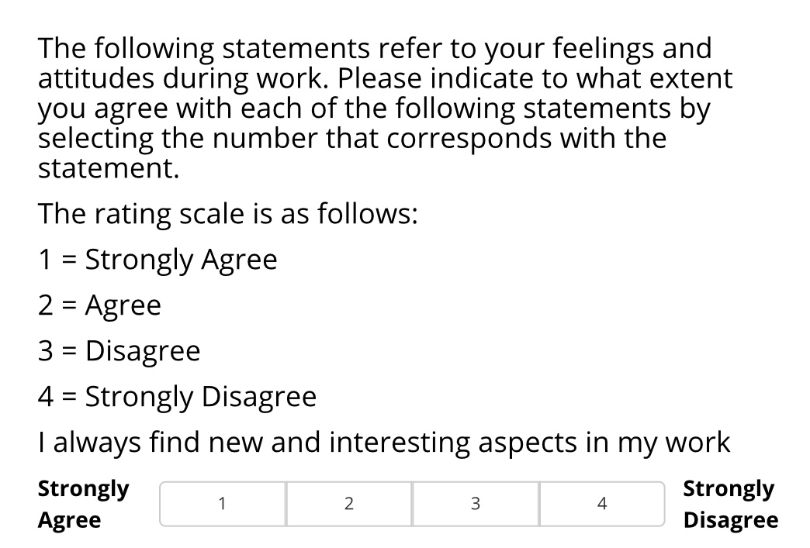
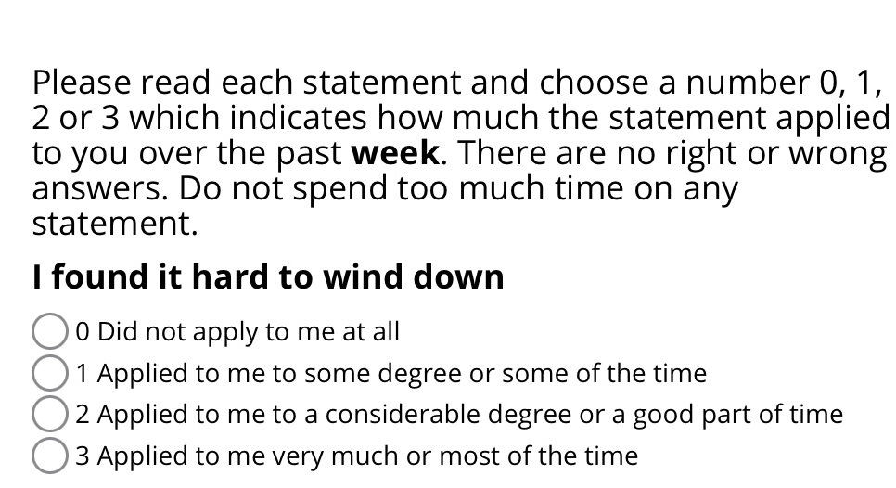
OLBI Item
DASS Item
Notes:
-Higher scores for the DASS suggest more Deppression anxiety and stress
-Higher Scores for the OLBI indicate more burnout. However, this question is reverse scored; therefore, lower scores indicate higher burnout.

