Slide 1
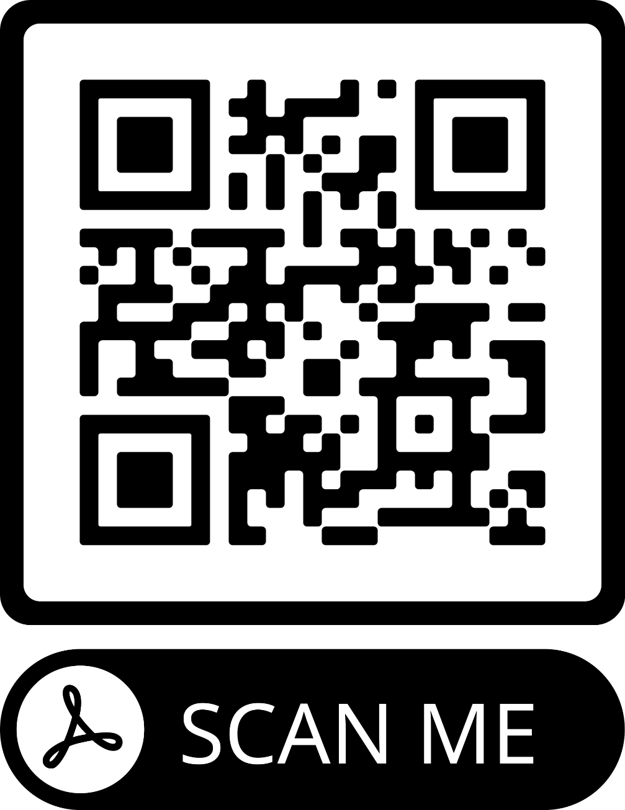
Emotion regulation, mental health, and well-being in commercial content moderators
Hayleigh Armstrong, Casey Hopper, and Catherine N. M. Ortner
Kamloops, BC, Canada
Introduction
Content moderators screen social media content that has been flagged as inappropriate (Roberts, 2020). Repetitive exposure to explicit material may increase moderators' symptoms of psychopathology (e.g., depression or anxiety) and decrease well-being (Steiger et al., 2021).
Emotion regulation—how we modify our experience or expression of emotions and the type of emotions experienced (Gross, 2015)—may predict mental health and well-being outcomes in this population. However, we know of no published research investigating emotion regulation in commercial content moderators.
Using an online self-report questionnaire methodology, we shall examine the associations between emotion regulation, emotion beliefs (controllability and usefulness), flexibility, perceived control, psychopathology (anxiety, depression, stress, burnout, and PTSD), and well-being in commercial content moderators.
Participants and Design
Participants (N = 200, aged 18-55, living in the US or Canada and fluent in English) will be recruited via email from Rebuilding Thoughts, an emotional wellness service offering employees one-to-one and group therapy/coaching. Participants must have been employed as a content moderator for a minimum of three months.
Participants will complete the self-report measures at time T1 and T2 (6 months later).
Conclusions
Overall, the study will provide insight into the incidence of symptoms of psychopathology in commercial content moderators, as well as which emotion regulation strategies may be associated with better or worse mental health outcomes in content moderators.
This research is critical since there has been a lack of research focusing on mental health and well-being in content moderators, whose role is becoming increasingly important in our society.
Ultimately, this study will lead to future research to design effective interventions to promote well-being in this vulnerable group.
Expected Results
We shall use regression to assess whether strategy use, emotion beliefs, and flexibility at T1 predict mental health and well-being at T2.
We expect that flexibility, personal control, and controllability and usefulness beliefs will predict emotion regulation strategy use, which will in turn predict well-being and psychopathology.
References
Gross, J. J. (2015). Emotion Regulation: Current Status and Future Prospects. Psychological Inquiry, 26(1), 1–26. https://doi.org/10.1080/1047840X.2014.940781
Roberts, T.S. (2020). Behind the Screen: Content Moderation in the Shadows of Social Media [eBook edition]. Yale University Press: New Haven. https://doi.org/10.1177/0267323120912634
Steiger, M., et al. (2021). The psychological well-being of content moderators: The emotional labor of commercial moderation and avenues for improving support. Proceedings of the 2021 CHI Conference on Human Factors in Computing Systems, 341,1-14. https://doi.org/10.1145/3411764.3445092
Measures
Emotion regulation strategies:
Cognitive Emotion Regulation Questionnaire (Garnefski et al., 2001)
Non-Judgment Scale (Bohlmeijer et al., 2011)​
Emotion Regulation Questionnaire (Gross & John, 2003)​
Emotion Beliefs:
Emotion Beliefs Questionnaire (Becerra et al., 2020) ​
Emotion Regulation Flexibility:
Emotion Regulation Flexibility-10 (Dorfel et al., in prep.)​
Personal Control:
Pearlin Mastery Scale (Pearlin & Schooler, 1978)
Mental Health:
Posttraumatic Stress Disorder Checklist for DSM-5 (Blevins et al., 2015) ​
Depression Anxiety Stress Scale (Lovibond & Lovibond, 1995).
Oldenburg Burnout Inventory (Demerouti et al., 2010)
Well-being:
Huta’s Well-Being Scale (Huta, 2013) ​
WHO-Five Well-being Index (Topp et al., 2015)
Table 1. Strategy-specific predictions: XX indicates predicted positive associations. YY indicates predicted negative associations.
 | Emotion beliefs | Anxiety, depression and PTSD | Well-being | Burnout
Reappraisal
Expression Suppression
Rumination
Acknowledgements
The authors would like to thank Nadia Brown, Managing Partner of Rebuilding Thoughts, for her collaboration on this project (providing access to participants and funding for participant compensation).

